Slide 1
Innovations in the respiratory ecosystem to support safe oxygen use with CPAP for Small and Sick Newborn Care to achieve ENAP Target 4
May 10, 2023, 11:50 - 13:05
Notes:
General tips
Avoid flashy transitions, elaborate animations or sound effects: they can be distracting, and they also add to your file size so that your presentation might be difficult to load.
Simplicity: simple, consistent slide layouts work best in ensuring your audience can follow along.
Slide backgrounds should be subtle so that your content stand out.
Leave some empty space: clutter reduces readability. Leave breathing room around text and image, so that they are easily distinguishable at a distance.
Standardize position, colors, and styles.
Font and text styles
Use a standard font that comes with the PowerPoint package to ensure your formatting will stay the same on different computers.
Please use Calibri font.
Use bold and large font for headlines. Avoid all caps.
Font size should be no smaller than 24pt; to test readability, stand back 2m from the monitor to see if you can still read the slides.
All headlines should be the same font, and all body text should be the same font, so that the audience knows what to expect.
Limit content to around 6 bullet points per slide. Use short sentences.
Use a single style of bullets throughout the presentation.
Colors
Color of text should clearly stand out from the background.
Consider the accessibility of different colors; some vibrant colors can be difficult to see on screen, especially for people with color-blindness. Some color combinations to avoid include:
Red and green
Green and brown
Blue and purple
Green and black
Avoid using too many colors in one chart. Use different shades of colors can help if you have many datapoints to represent.
Imagery
Use high quality images.
Use one or two large images per slide, instead of many small images that are hard to see from a distance.
Arrange images on a grid.
Callouts
Consider building callouts (arrows and circles) in your presentation to highlight important details.
Limit content to around 6 bullet points per slide. Use short sentences and use a single style of bullets throughout the presentation.

Slide 2
To achieve the 2030 SDG-era targets, IMNHC 2023 aimed to lead with evidence, share effective implementation strategies, review joint progress, and nurture collaboration and innovation within the maternal and newborn health community

Slide 3
Quick Facts
Four days
Over 1600 attendees
Over 95 countries represented
Official delegations from the Ministries of Health of 28 countries
Over 180 different sessions held

Slide 4
Conference Objectives
Enable pathways to drive collaboration, coordination, cross-country learning, and alignment within the maternal and newborn health community.
Lead with evidence, share successes and effective implementation strategies, and identify promising solutions to improve maternal and newborn health and prevent stillbirths.
Review and recognize country, regional, and global progress toward MNH targets and milestones.
Prioritize actions to accelerate progress towards meeting the 2030 Sustainable Development Goals.
Build a dynamic community, including engaging the next generation of leaders.

Slide 5
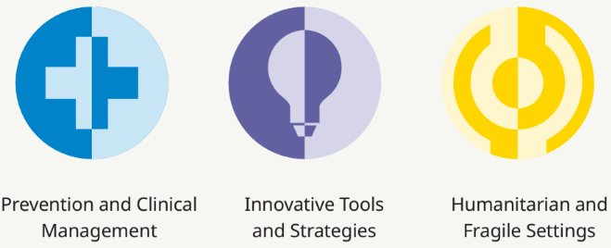
Conference Themes

Slide 6
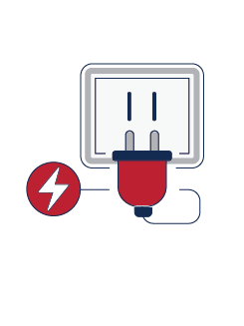
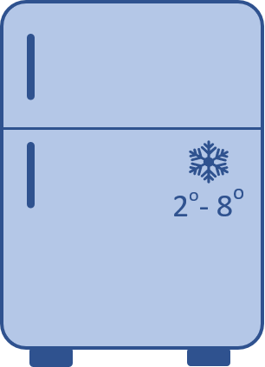
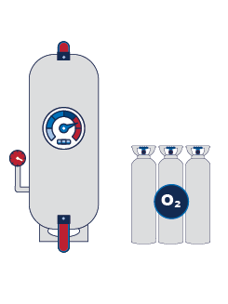
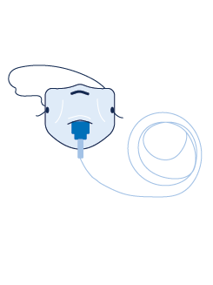
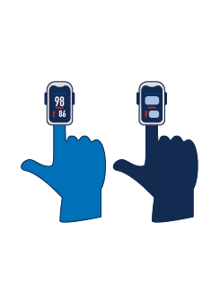
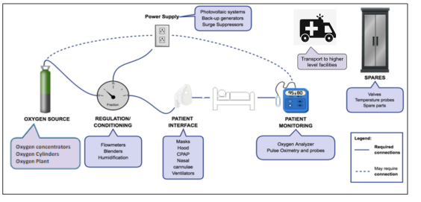
Oxygen Ecosystem for ALL
Transport to higher level facilities
Photovoltaic Systems
Back-up Generators
Surge Suppressors
SPARES Valves Temperature probes
Spare parts
Flowmeters
Blenders
Humidification
Masks
Hood
CPAP
Nasal
Cannulae
Ventilators
Oxygen Analyzer Pulse Oximetry and probes
Legend:
_______ Required connections - - - - - - - - May require connections
Oxygen Concentrators
Oxygen Cylinders
Oxygen Plant

Slide 7
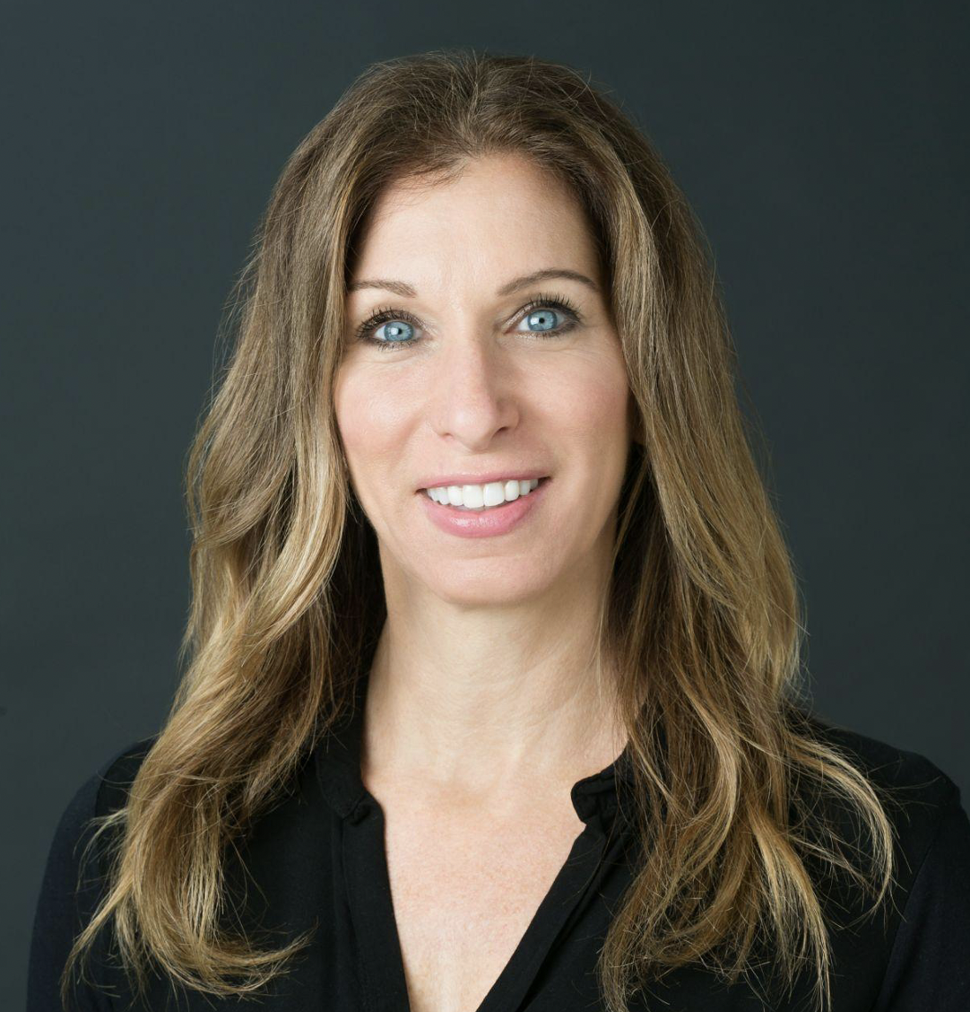
Chasing the ENAP target with safe and effective oxygen from the Respiratory Ecosystem lens
Dr. Leah Greenspan, Senior Newborn Advisor and Neonatologist, USAID Global Health Bureau
Dr. Leah Greenspan is a board-certified Pediatrician and Neonatologist. She has worked clinically in the Washington DC area for almost 20 years. Dr. Greenspan has extensive experience working in Global Health with a focus on newborn health in Sub Saharan Africa and Asia. Prior to joining the team at USAID as Sr. Newborn Advisor in March of 2020, she worked with multiple NGOs as a Newborn Consultant developing and implementing programs both in the rural and urban settings to build the capacity of medical professionals and strengthen health systems around the continuum of maternal newborn care. As a member of the Newborn Team at USAID, Leah is a Senior Newborn Advisor focusing on advancing small and sick newborn care globally as well as being a key member of the MCHN Office Commodities and Supply chain team, co-lead of Every Newborn Action Plan-Commodities team and co-lead for the MCHN oxygen coalition.

Slide 8
Why?
63
Countries off track to meet the SDG for Newborn Mortality Rate (NMR)
30
Million newborns require inpatient care each year
1 in 5
Children that reach a health facility needing oxygen support actually receive it
Prematurity is the number one cause of neonatal mortality with respiratory distress syndrome contributing to 45% of case-fatality rates
1
CPAP is the one intervention with the greatest impact on preterm mortality
Cochrane review found that CPAP reduces the risk of mortality by 48%
100%
Oxygen use, improvised circuits and unregulated pressures can lead to ROP, BPD and brain injury
Notes:
1.-In most of africa 1 in 5 children that need oxygen support actually receive it
2. 63 countries are off track to reach the SDG
3.Providing safe oxygen to newborns with respiratory distress is critical to provide quality of care to the 30 million newborns requiring inpatient care each year.
4. No country will reach the SDG and ENAP targets without providing quality of care for Small and sick newborns
5. Providing safe oxygen to newborns with respiratory distress is critical to provide quality care to the 30 million newborns requiring in patient care each year
6.access to and appropriate us of oxygen reduces death from childhood pneumonia and neonatal respiratory distress syndrome
7.Most facilities in LMIC using CPAP to treat newborns use 100% oxygen and improvised circuits leading to ROP, BPD and brain injury
8.Unregulated oxygen use can lead to long term disabilities such as blindness and chronic lung disease
9.The use of long thin tubing with improvised circuits can lead to excessive pressures (Poiseuille’s Law). Pressure results from resistance not immersion of the distal end of the tube.

Slide 9
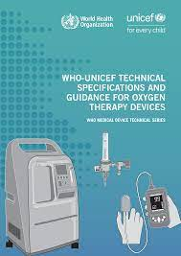
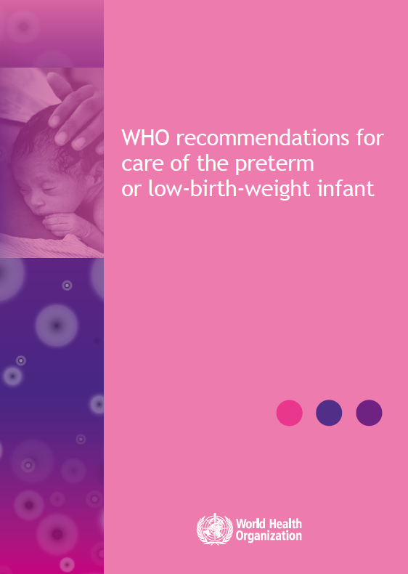
Newborn specific global guidance
Quality statement 8.3: Equipment designed specifically for the medical care and developmental and emotional support of small and sick newborns is available at all times
CPAP therapy is recommended in preterm infants with clinical signs of RDS
CPAP therapy is considered immediately after birth for very preterm infants (<32weeks) with/without signs of RDS
For preterm infants who need CPAP therapy, bCPAP may be considered rather than other pressure sources
Notes:
What about do no harm paper or respiratory care for children
: Small and sick newborns require specifically designed equipment in appropriate sizes for medical and developmental care and emotional support. Functioning newborn equipment is required for neonatal emergency resuscitation with airway, breathing and circulation support and continuous care. Effective administration of oxygen to newborns requires equipment of the Quality statement 8.3: Equipment designed specifically for the medical care and developmental and emotional support of small and sick newborns is available at all times. 129 correct size. All equipment must be well maintained, with instructions available in a clear, legible format for resolving any problem with equipment. A well-equipped allied health therapy unit should be available for neurodevelopmental support of small and sick newborns.
The health facility has a safe, uninterrupted source of medical gases (air and oxygen), oxygen blender and equipment for delivery of respiratory support (age-appropriate nasal prongs, catheters, face masks, humidifier, pulse oximeter) available at all times in the neonatal unit and emergency areas.

Slide 10
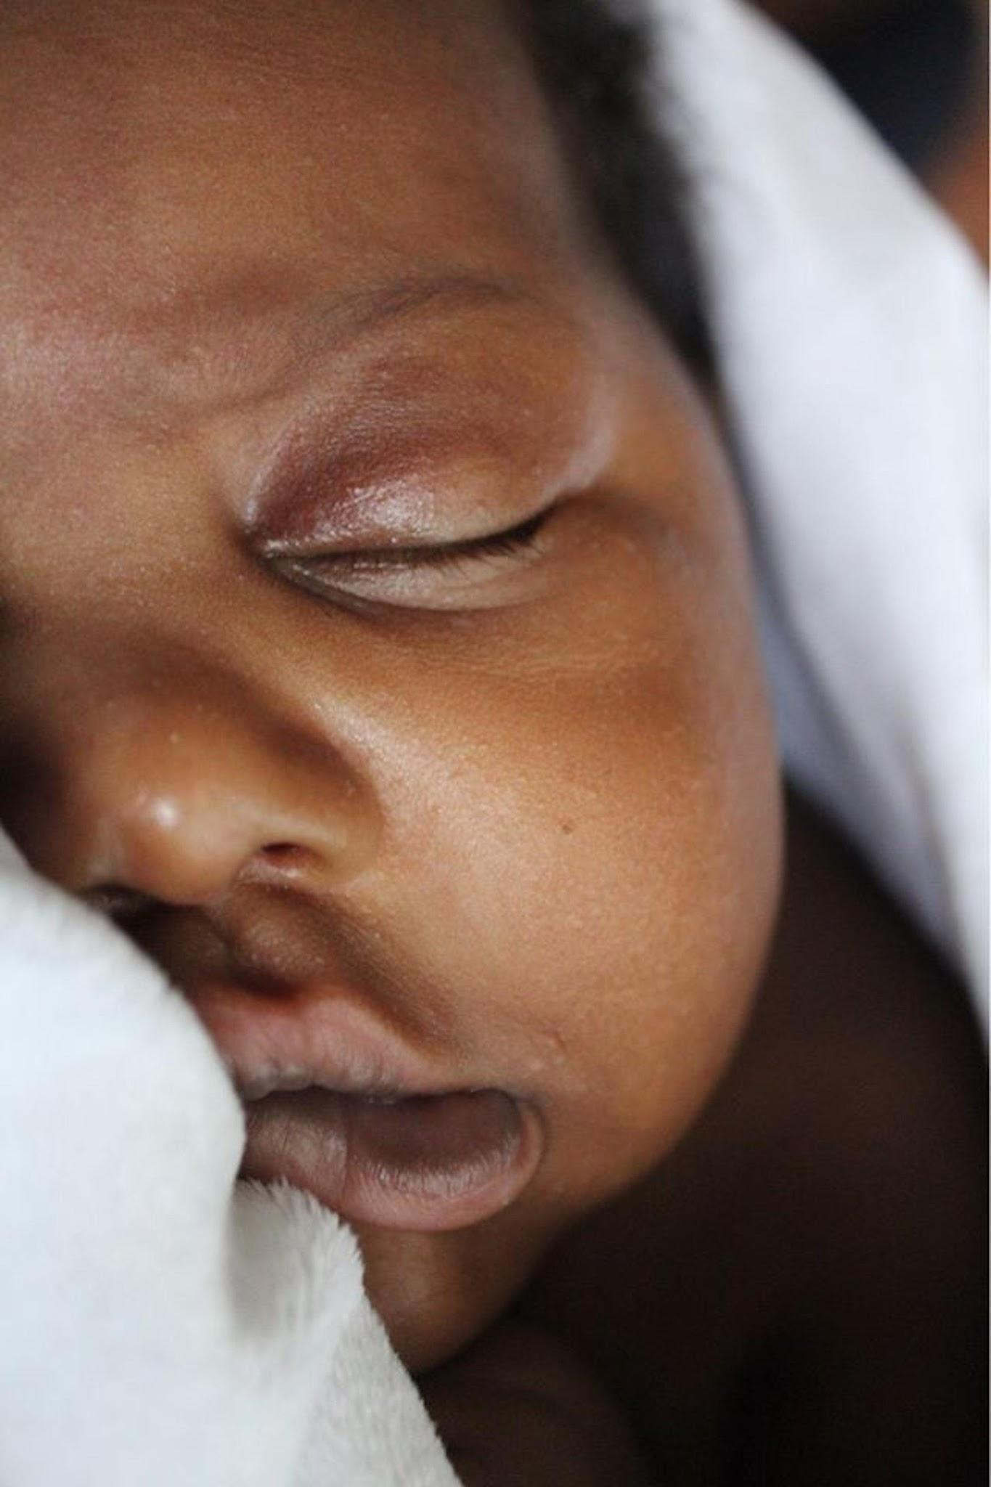
Level 1 Immediate and essential newborn care
Immediate newborn care (delayed cord clamping, drying, skin to skin etc.)
Neonatal resuscitation for those who need it
Breastfeeding early initiating and support
Essential newborn care identification and referral of complications
Targeted care as needed (e.g., PMTCT of HIV)
Level 2 Special newborn care
Thermal care including KMC for all stable neonates < 2,000gms
Assisted feeding and IV fluids
Safe administration of oxygen
Detection and management of neonatal sepsis with injection antibiotics
Detection and management of neonatal jaundice with phototherapy
Detection and management of neonatal encephalopathy
Detection and referral/management of congenital abnormalities
Management of preterm respiratory distress with CPAP
Transition
Follow up of at-risk newborns
Exchange transfusion
Coverage Target 4
Global target
80% of countries have a national implementation plan that is being implemented in at least half the country, with an appropriate number of functional level-2 inpatient units linked to level-1 units to care for small and sick newborns, with family-centered care.
National and Subnational targets
80% of districts (or equivalent subnational unit) have at least one level-2 inpatient unit to care for small and sick newborns, with respiratory support including provision of continuous positive airway pressure

Slide 11
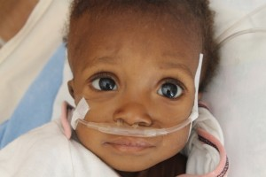
Safe and effective oxygen use
Oxygen is essential for life but it can also be toxic – FIRST, DO NO HARM
Common practices that can harm newborns:
100% oxygen administration
Unmonitored oxygen
Prophylactic administration without clinical
indication
Interrupted oxygen administration
Oxygen toxicity can lead to:
ROP and vision impairment
#1 cause of child blindness
BPD increases the risk of long-term respiratory complications with increased
hospitalizations, greater need for respiratory medications and respiratory morbidities

Slide 12
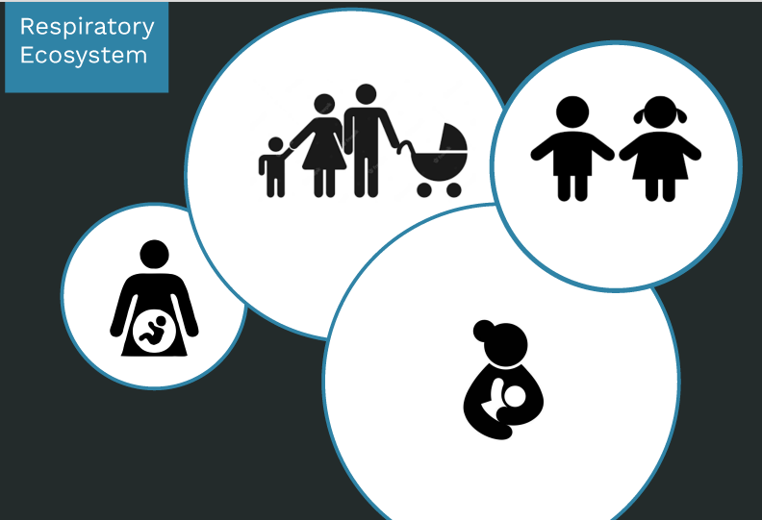
What is the respiratory ecosystem?
Respiratory ecosystem is a set of processes, tools, and technologies deployed to address respiratory conditions across the MNCH continuum of care
For newborns, it includes a bundle of interventions for safe and effective oxygen provision

Slide 13
Oxygen Ecosystem for ALL
Transport to higher level facilities
Photovoltaic Systems
Back-up Generators
Surge Suppressors
SPARES Valves Temperature probes
Spare parts
Flowmeters
Blenders
Humidification
Masks
Hood
CPAP
Nasal
Cannulae
Ventilators
Oxygen Analyzer Pulse Oximetry and probes
Legend:
_______ Required connections - - - - - - - - May require connections
Oxygen Concentrators
Oxygen Cylinders
Oxygen Plant

Slide 14
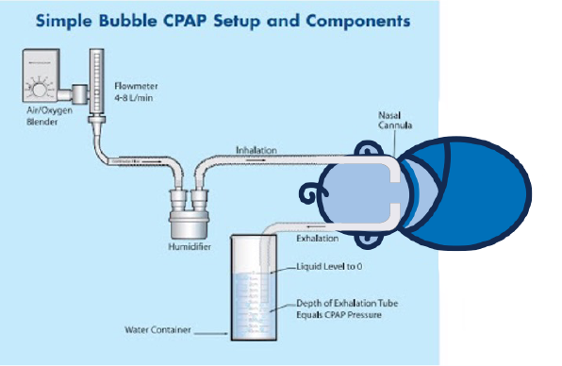
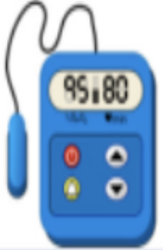
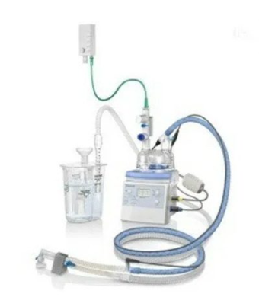
Respiratory Ecosystem for the NEWBORNS
Global Guidance
DO NO HARM
Resuscitation
Surfactant
Caffeine Citrate
Oxygen saturation targeting
Bubble CPAP
Respiratory
Distress
Syndrome
Surveillance
And referral systems

Slide 15
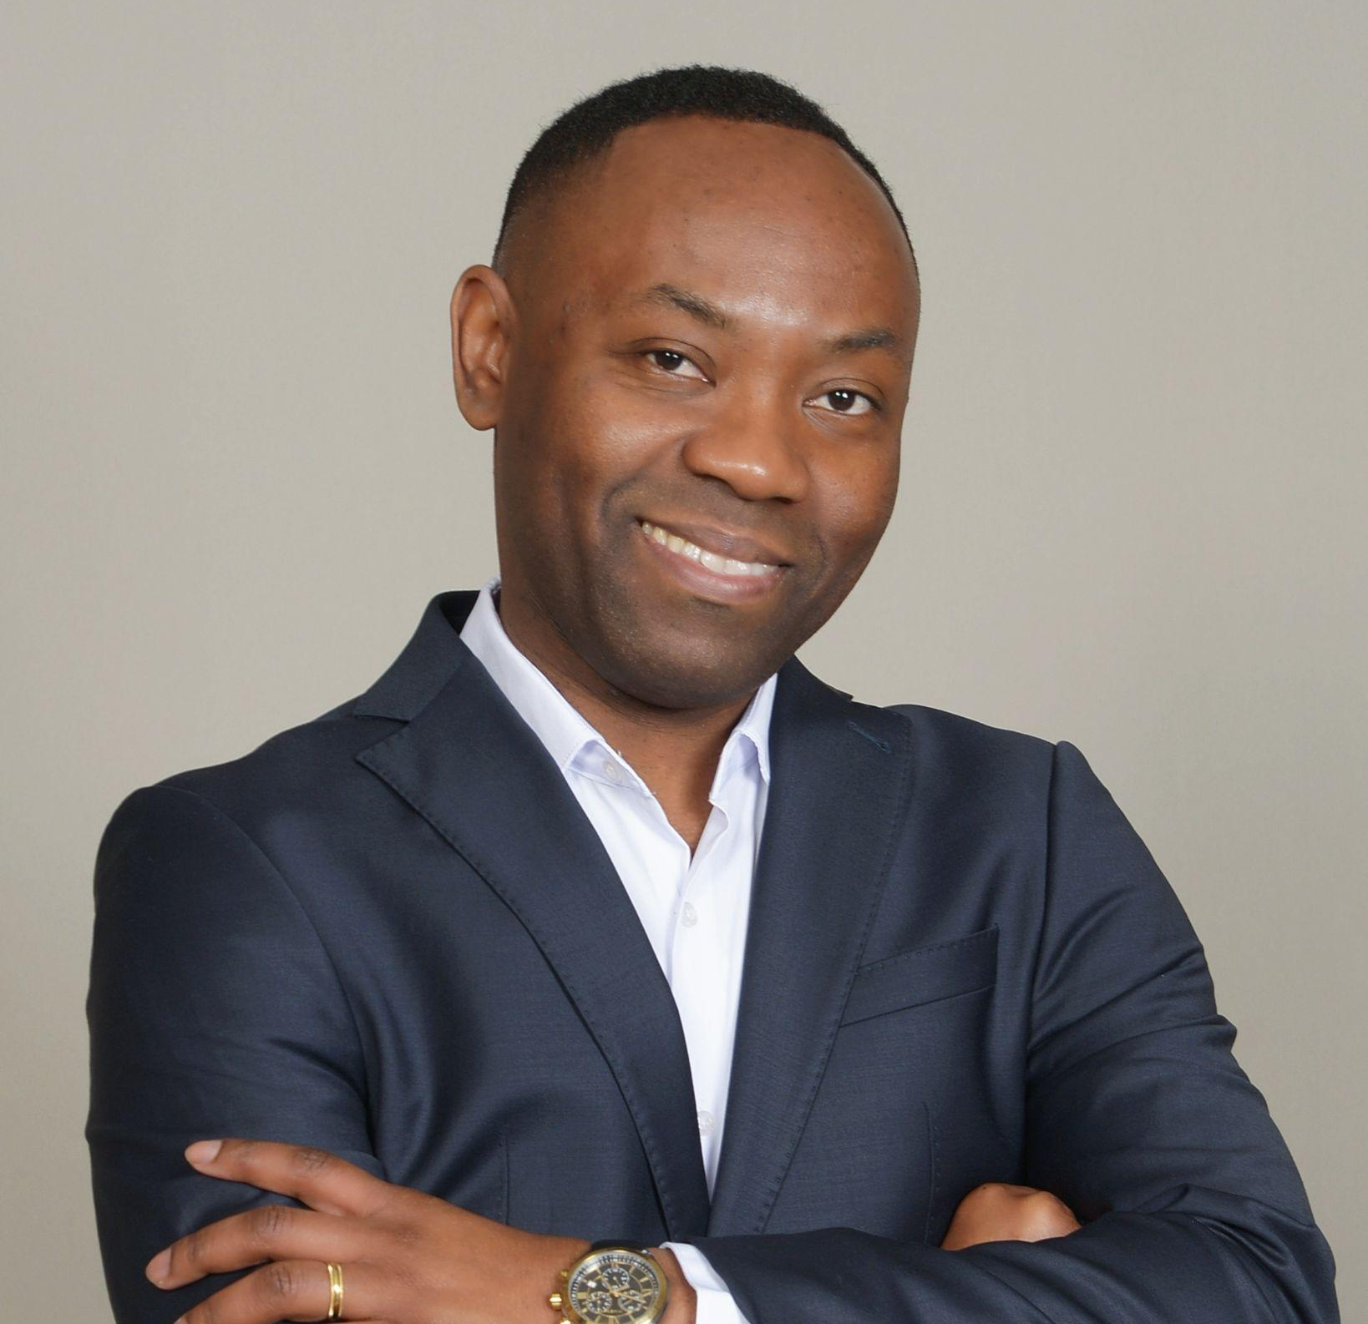
Situational analysis of prevalence of improvised Bubble CPAP (bCPAP), 100% oxygen use and pulse oximetry monitoring use in level 2 facilities in Ghana
Tamah Kamlem, Senior Technical Advisor, MNCH, GHSC-PSM
Tamah Kamlem is the Senior Technical Advisor for Maternal, Neonatal, and Child Health (MNCH) Task Order at the Global Health Supply Chain Program – Procurement and Supply Management (GHSC-PSM). The focus of his work includes policy, procurement, data analytics, and technical project implementation in multiple countries.
Mr. Kamlem is a multilingual development professional with over ten years of work experience in supply chain, global health, project implementation, and Monitoring, Evaluation and Learning. He brings experience in the areas of MNCH (maternal neonatal and child health), control tower operations, forecasting, and health system strengthening. As an analyst for the GFPVAN, he supported the onboarding of over 20 countries in sub-Saharan Africa, South-east Asia and the LAC region. Tamah has worked on projects addressing child health, HIV/AIDS, human resources for health, and non-communicable diseases. Tamah has co-authored multiple scientific publications, most recently on containing the spread of HIV/AIDS in West Africa and the use of health communication for epidemic prevention. He holds a Master of Public Health in global health policy from the George Washington University.

Slide 16
Background
A 2018 Ghana statistical survey showed a 14% reduction in the neonatal mortality rate, from 29 to 25 per 1,000 live births between 2014 and 2017
Neonatal mortality rates in Ghana remain high
Previous assessments indicated challenges around availability of medical equipment necessary for the care of SSNB
Preliminary findings: A comprehensive assessment of newborn medical devices, commodities, and providers’ capacity in the public health sector of Ghana

Slide 17
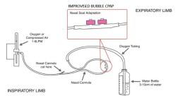
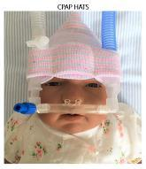
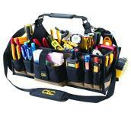
Primary Objective
Specific Objectives
To conduct a comprehensive assessment of newborn medical devices, commodities, and
providers’ capacity with focus on a comprehensive review of the respiratory ecosystem.
Conduct situational analysis of the prevalence of improvised bubble CPAP (bCPAP), 100% oxygen use and pulse oximetry monitoring use in health facilities in Ghana
Identify data gaps regarding respiratory support and oxygen ecosystem for the care of small and sick newborns (SSNBs)
Investigate health staff capacity to manage and maintain devices critical to ensure adequate respiratory support for small and sick newborns
Evaluate maintenance protocols for medical devices for newborn care

Slide 18
Methodology
A mixed method approach was adopted for the study
Quantitative
Qualitative
Geographic coverage: The Northern and Upper West Regions
Census of all hospitals and polyclinics within the public health sector
Purposive selection of health centres and CHPS compounds that recorded at least 300 deliveries in 2022
51 health facilities selected (24 hospitals, 5 polyclinics, 18 health centers and 4 CHPS compounds)
Semi-structured interview guide used with key informants to obtain secondary data on newborn devices and oxygen ecosystems for facilities
Two independent qualitative experts conducted data transcription and analysis
Transcription data analyzed using thematic review
Notes:
Data collection was done using Kobo Collect. Quantitative output generated using Microsoft Excel 2016 and SPSS

Slide 19
Preliminary Findings: Neonatal Unit
Neonatal Services Provided
Neonatal Admission
Infrastructure
Electricity
Neonatal Admission
Neonatal Services provided
Human Resources
Infection Prevention and Control
Waste Management
Sources of water
Inventory and Forecasting of Consumables
Newborn Care Equipment
and Supplies
Inventory and Forecasting of Consumables
Newborn Care Equipment
and Supplies

Slide 20
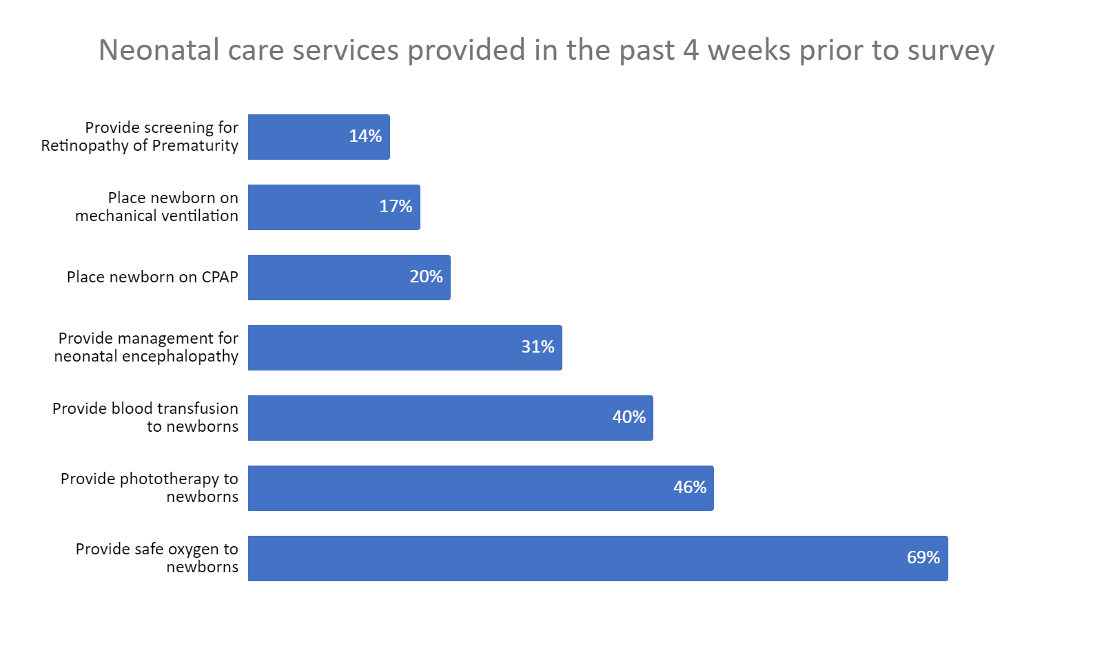
Neonatal Services Provided

Slide 21
Neonatal Unit Electricity
Availability of back-up electrical power for facilities
Types of equipment covered by fuel-operated generator
86%
81%
81%
70%
71%
71%
62%
60%
50%
48%
40%
33%
33%
30%
29%
20%
10%
8%
3%
0%
Fuel operated generator
Battery Inverter
Solar power
Phototherapy Light | Radiant Warmer | Oxygen Concentrator | Incubator | Suction Pump | Pulse Oximeter | Syringe Pump | CPAP | Other
Notes:
Facilities with solar power use it as a back-up energy source for all equipment in the neonatal unit
The following equipment are covered by battery inverter:
Incubator Radiant warmer
Phototherapy light
Syringe pump
Suction pump
CPAP

Slide 22
Inventory and Forecasting of Consumables
Availability of consumables inventory register/ system at neonatal unit
Ordering frequency for consumables at neonatal unit
70%
48%
30%
28%
21%
3%
Inventory system available
Inventory system not available
1 month before running out of stock
1 week before running out of stock
When we run out of stock
Other

Slide 23
Inventory and Forecasting of Consumables
Frequency of inventory count for consumables at neonatal unit
50%
21%
18%
11%
At least once per month
At least once per week
Daily
Irregularly

Slide 24
Newborn Care Equipment and Supplies
Availability of devices/equipment for newborn care
Indirect ophthalmoscope (with small pupil adjustments)
CPAP driver system (bubble CPAP)
CPAP driver system (standard CPAP)
Suction pump (manual, non-electric power dependent)
Suction pump (portable, electrical) Oxygen flow splitter for newborn
Oxygen humidifiers Oxygen concentrator Oxygen, bottled/cylinder Oxygen Blenders Respiratory Rate Monitor
Apnea Monitor T piece resuscitator
Neonatal sized face masks (size 1) Neonatal sized face mask-preterm (size 0) Bag self-inflating (neonatal size)
Patient monitors (can measure at least 3 of: NIBP, HR, SpO2, ECG, RR, Temp)
Recharger for Batteries (for pulse oximeter, match pulse oximeter batteries) Neonatal sized pulse oximetry probes/sensors (reusable)
Pulse Oximeter
0%
10% 20% 30% 40%
Available today, but not functional
50% 60%
Not available today
70%
80%
90%
100%
Available today and functional

Slide 25
Newborn Care Equipment and Supplies
Availability of consumables for neonatal care
Distilled water
CPAP tubing CPAP prongs
Regular standard cannula Improvised cannula Neo Ram cannula Hudson Prong
CPAP hats and associated accessories
Suction pump accessories
Oxygen Cannula Oxygen concentrator filters Nasal prongs (2 mm)
Nasal prongs (1 mm) Resuscitation mannequin (for practice)
Penguin sucker
Probes for patient monitor
Neonatal sized pulse oximetry probes/sensors (consumable)
Oxygen tubing
0%
20%
40% 60%
Available today, but stockout in last 4 weeks
80%
100%
Available today and no stockout in last 4 weeks
Not available today

Slide 26
Maintenance and Repair
Availability of performance and safety analyzers
82%
18%
6%
6%
0%
Oxygen analyzer
Phototherapy radiometer
Gas flow and pressure gauge
analyzer
Gun thermometer
None of the above

Slide 27
Human Resources
Staff trained in the provision of care for SSNBs
General Nurse |  |  |  |  |  |  | 81%
General Medical Doctor |  |  |  |  |  |  | 73%
Neonatal or Paediatric Nurse |  |  |  |  |  | 50%
Clinical Officer |  |  |  |  | 46%
Other please specify |  |  |  | 38%
Paediatrician |  |  | 23%
Neonatologist |  | 8%

Slide 28
Key Takeaways
The inadequate availability of newborn medical equipment in health facilities impacts effective management of care for SSNBs
Additional training on SSNB management needed for staff at all levels
Increased focus on forecasting and procurement of medical equipment is necessary
Recommended to develop and implement effective maintenance protocol for medical equipment

Slide 29
Decision support and CPAP model selection for effective implementation and uptake
Sara Liaghati-Mobarhan, Newborn Health Innovation Specialist and Biomedical Engineer, UNICEF
Sara Liaghati-Mobarhan is a biomedical engineer. As the Newborn Health Innovation Specialist at the Product Innovation Centre at UNICEF Supply Division, Sara focuses on adding innovative products to advance small and sick newborn care to the more than 2,000 products currently provided in UNICEF’s Supply Catalogue to respond to the needs of children and their families.
Prior to joining UNICEF, Sara worked as a biomedical engineer and educator with Newborn Essential Solutions and Technologies (NEST) and Rice360 Institute for Global Health Technologies for 5+ years, with a strong focus on newborn health technology management, distribution and implementation support. She acted as the NEST International Biomed Tech Training Director, where she collaborated with partners and stakeholders in Nigeria, Tanzania, Malawi and Kenya to strategically develop curricula, guide implementation activities and advocate policy change, integrating with pre-service and in-service teaching systems related to medical equipment & technology.

Slide 30
Decision support and CPAP model selection for effective implementation and uptake
Florin Gheorghe, Innovation Specialist and Biomedical Engineer, UNICEF
As an Innovation Specialist at the Product Innovation Centre at UNICEF Supply Division, Florin focuses on adding innovative products for oxygen therapy and delivery to the more than 2,000 products currently provided in UNICEF’s Supply Catalogue to respond to the needs of children and their families.

Slide 31
What factors matter most?
CRITICAL | USEFUL | OPTIMAL
Does it need air? Does it need oxygen? Does it need power? Humidification Cost Battery Oxygen blender Consumables Cleanability Ease of use Reusability | Bubble What’s included Alarms Usability Reprocessing ease Lifespan Accepts any circuit Oxygen consumption Transport Ability to titrate FiO2 | Other modes (i.e., HFT) Water trap Size, space, form PRV on expiratory Imposed work of breathing / resistance Pressure stability Electronic vs mechanical Air filters Bacterial filters Type of prongs

Slide 32
What factors matter most?
CRITICAL | USEFUL | OPTIMAL
Does it need air? Does it need oxygen? Does it need power? Humidification Cost Battery Oxygen blender Consumables Cleanability Ease of use Reusability YOUR EXPERIENCE | Bubble What’s included Alarms Usability Reprocessing ease Lifespan Accepts any circuit Oxygen consumption Transport Ability to titrate FiO2 | Other modes (i.e., HFT) Water trap Size, space, form PRV on expiratory Imposed work of breathing / resistance Pressure stability Electronic vs mechanical Air filters Bacterial filters Type of prongs

Slide 33
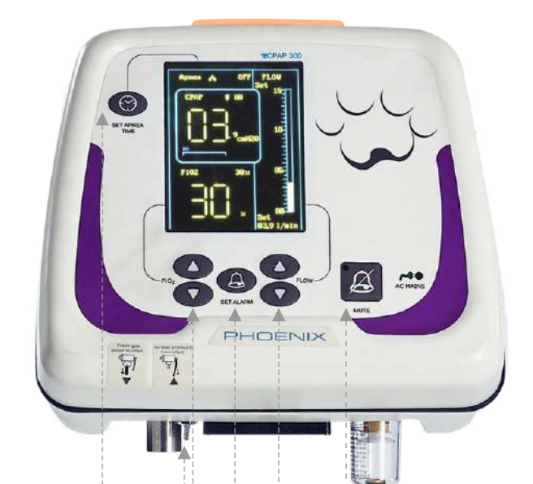
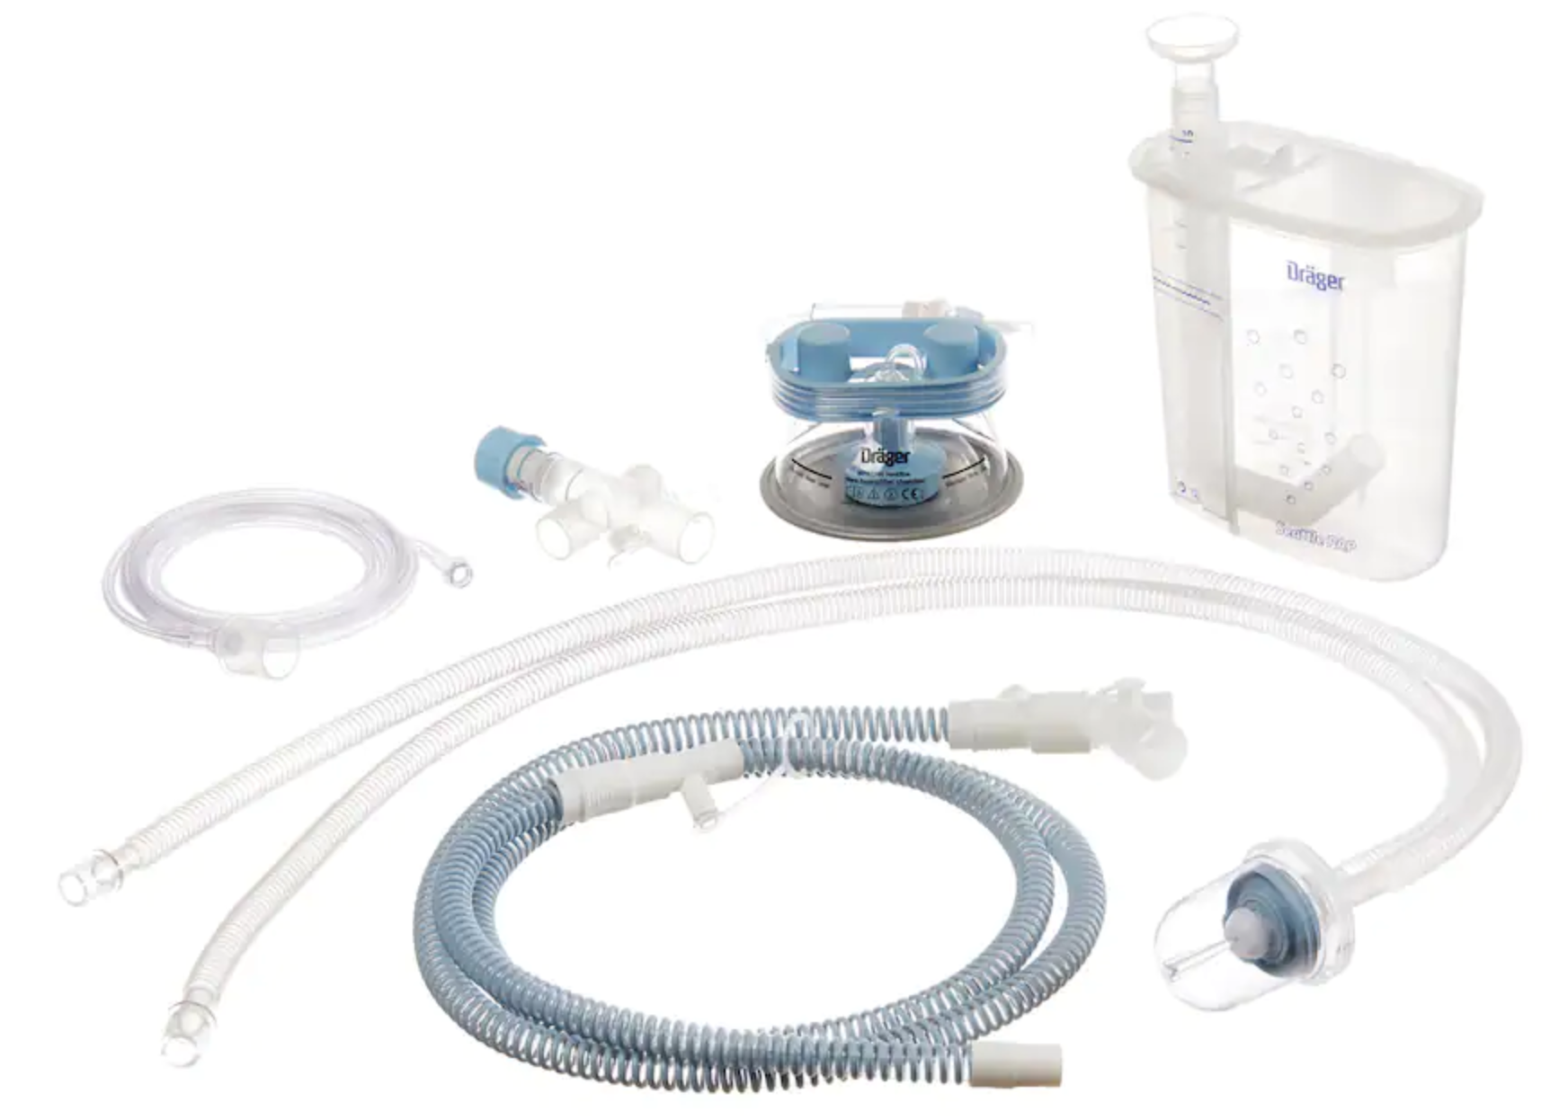
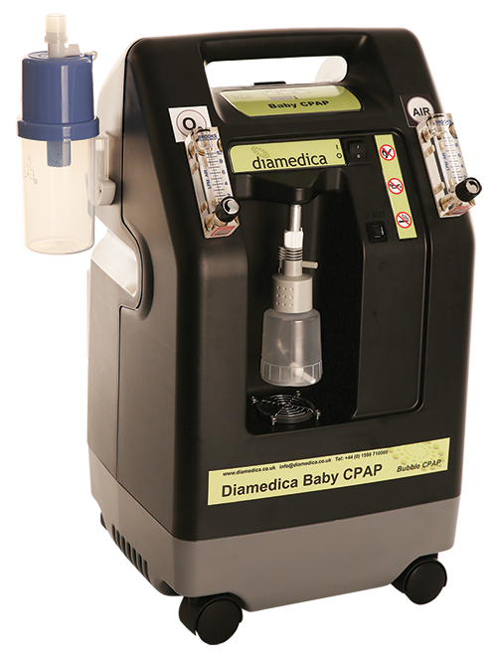
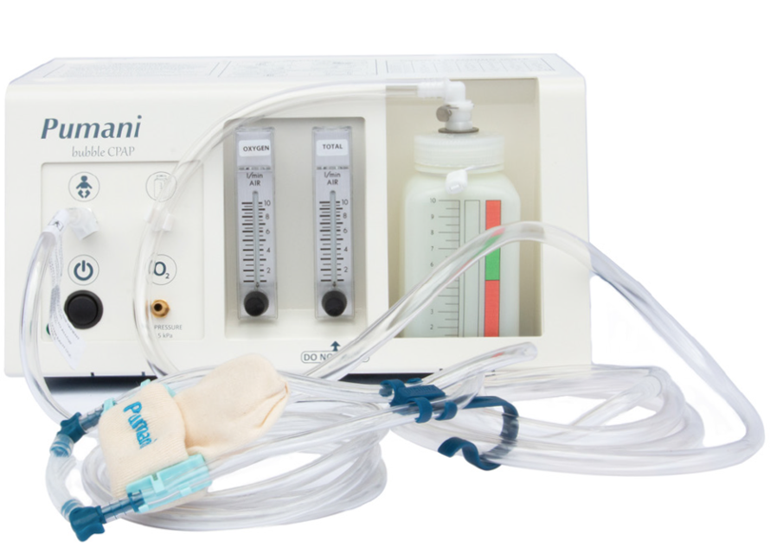
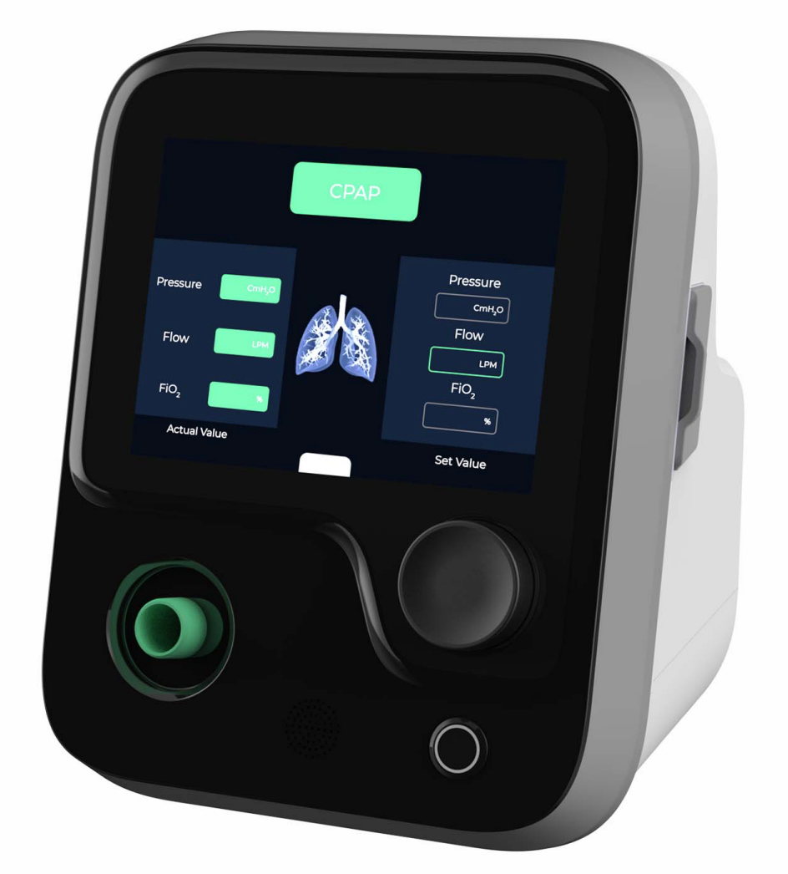
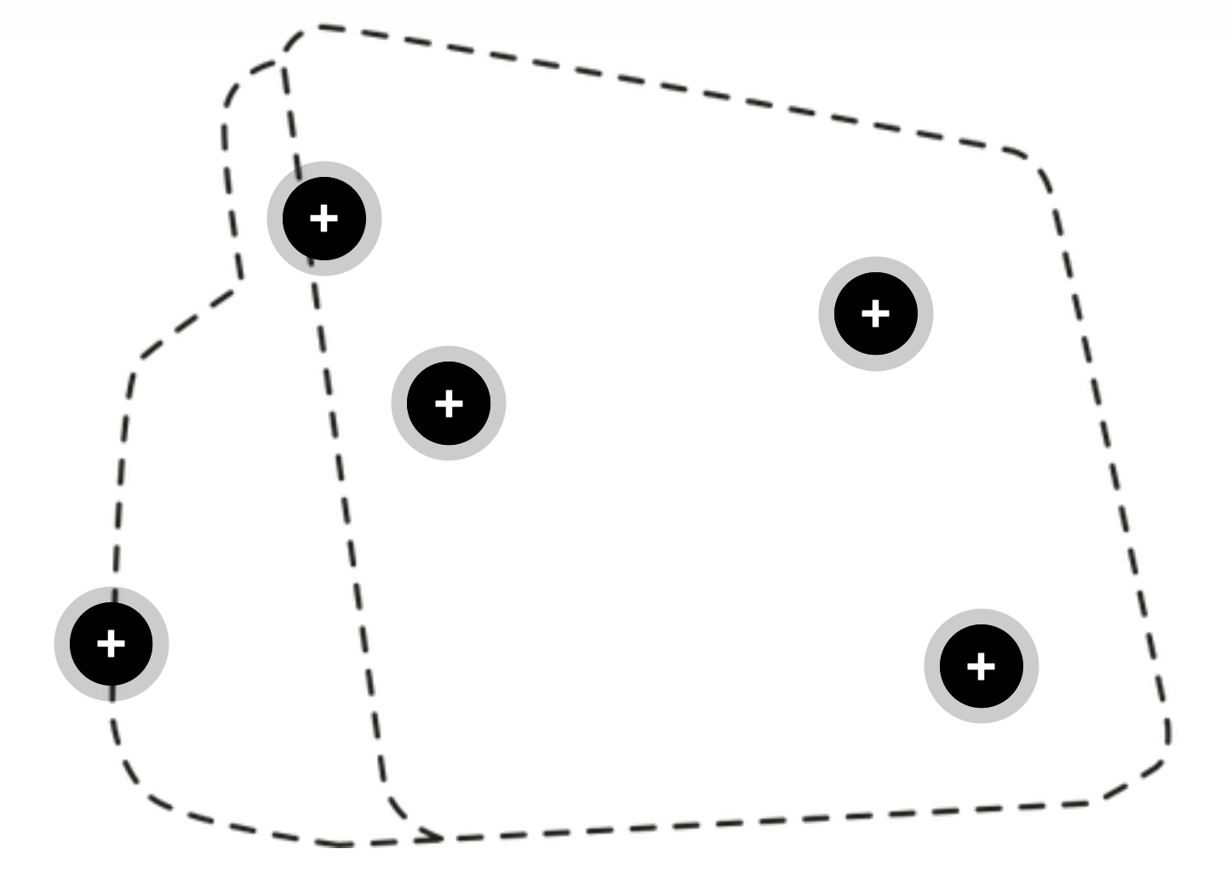
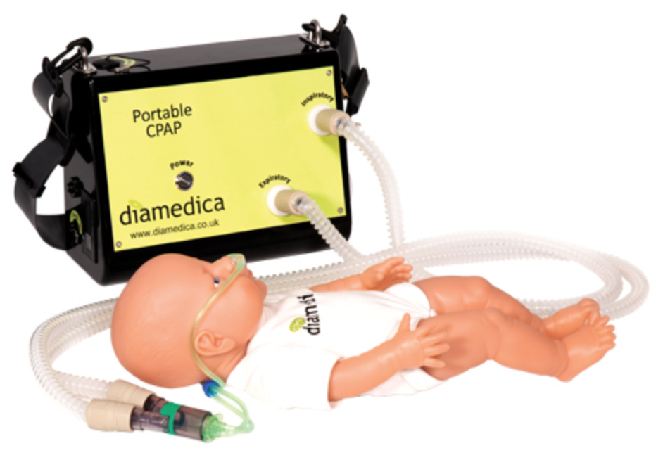
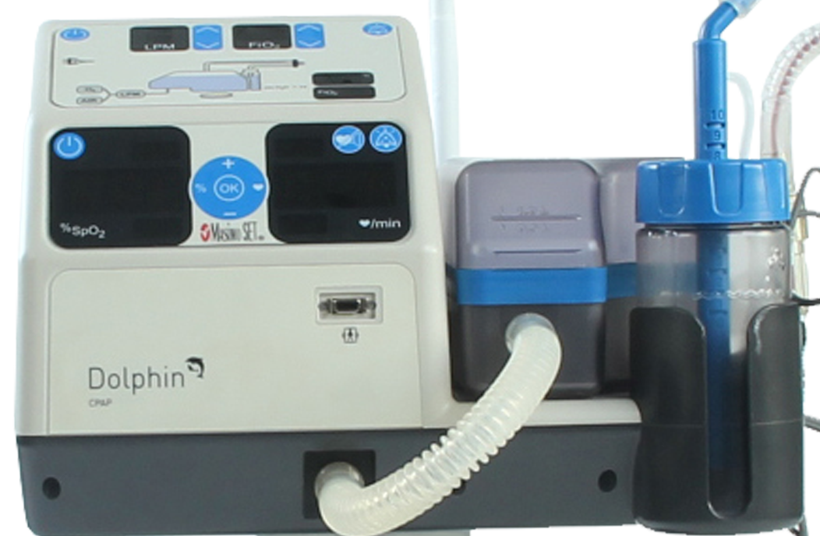
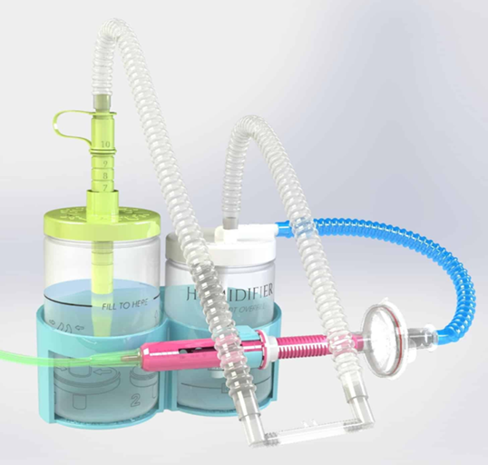
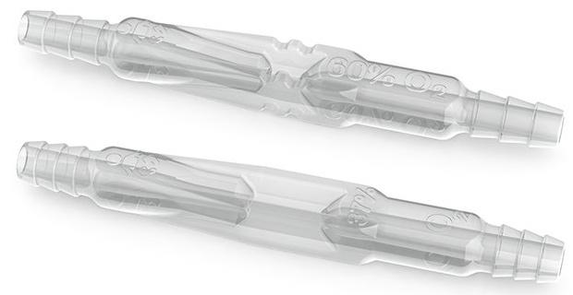
Product landscape
High pressure
Built-in oxygen
Any O2 source
Phoenix n300
Seattle PAP
Diamedica
Pumani
Saans
FlowLite
FPH Airvo3
Diamedica Transport
No power
MTTS Dolphin
Vayu
PATH blender

Slide 34
Product fit based on facility infrastructure
Is there power? | Reliable Power |  |  |  |  |  | Power Not Consistently Available |  |  |  |  |  | Low cost | Transport, power outage
Is there oxygen? | Yes |  |  |  | No |  | Yes |  |  |  | No
What type of O2? | Cylinder or piped |  | Oxygen concentrator |  | None |  | Cylinder or piped |  | Oxygen concentrator |  | None
Is medical air required? | Yes | No | Yes | No | Yes | No | Yes | No | Yes | No | Yes | No

Slide 35
Decision Support
Procuring the right products, numbers of devices, consumables and spare parts for comprehensive newborn care is essential to ensure appropriate implementation & uptake of bubble CPAP devices.
UNICEF is developing a digital procurement guide & forecasting tool linked to the UNICEF supply catalog, intending to:
Simplify product selection
Drive demand for comprehensive newborn care
Bundle for ease of purchase via unit category (e.g., devices, spares & consumables)
Focus on quality implementation

Slide 36
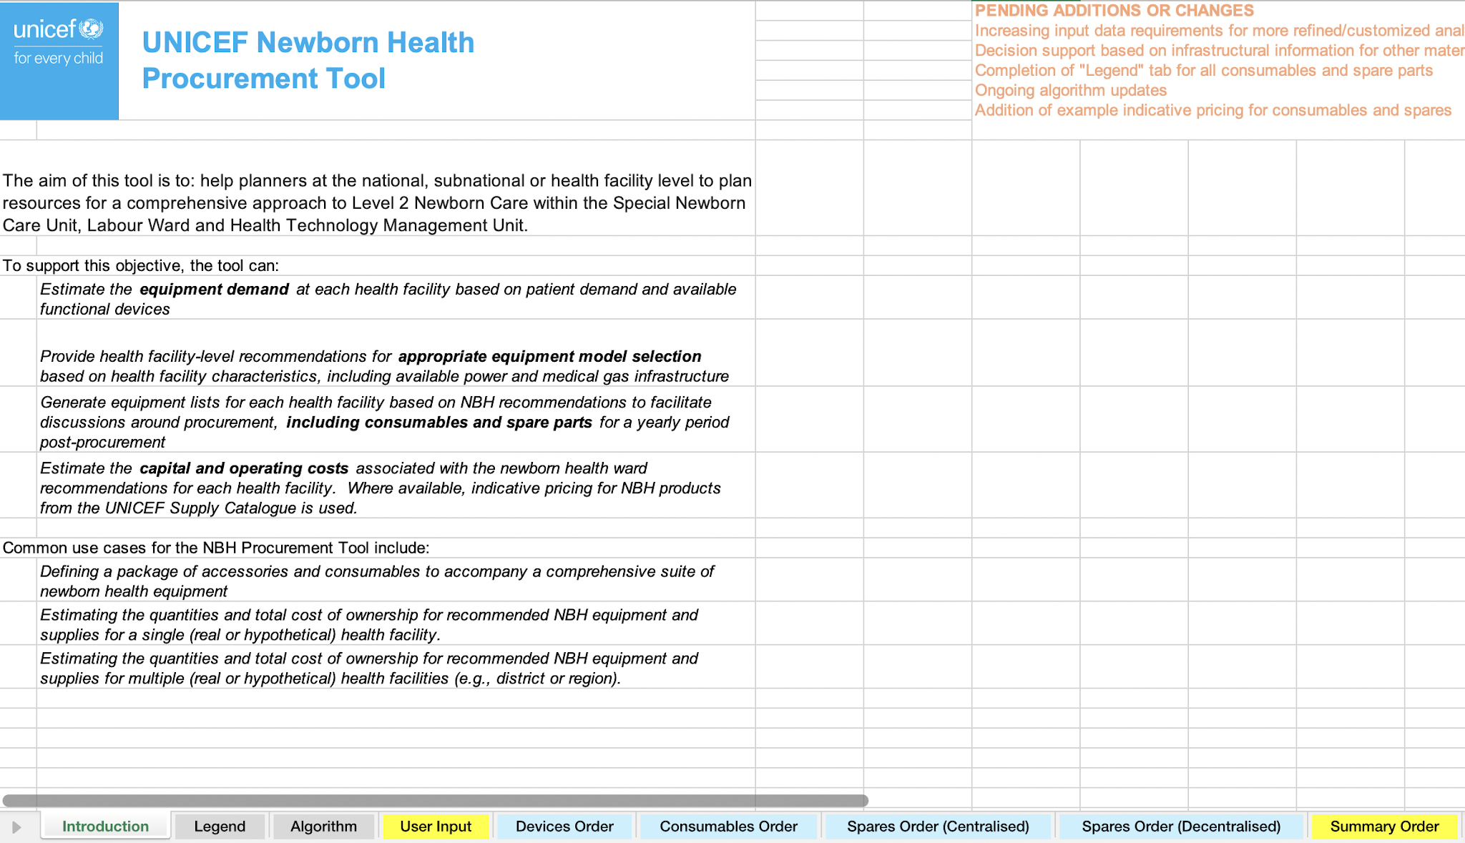
Devices, Consumables & Supplies
Notes:
Digital procurement guide & forecasting tool linked to the UNICEF supply catalog
Improve product availability by simplifying product selection & driving demand for comprehensive newborn care
Include newborn needs from Newborn Unit/Labour Ward/Health Technology Management Unit; training and care needs
Bundling for ease of purchase via unit category (e.g., devices, spares & consumables) and care pathway (e.g., jaundice management, thermal support)
Focus on appropriate selection within catalog/for each PO and quality implementation of these products

Slide 37
Devices, Consumables & Supplies
Notes:
Digital procurement guide & forecasting tool linked to the UNICEF supply catalog
Improve product availability by simplifying product selection & driving demand for comprehensive newborn care
Include newborn needs from Newborn Unit/Labour Ward/Health Technology Management Unit; training and care needs
Bundling for ease of purchase via unit category (e.g., devices, spares & consumables) and care pathway (e.g., jaundice management, thermal support)
Focus on appropriate selection within catalog/for each PO and quality implementation of these products

Slide 38
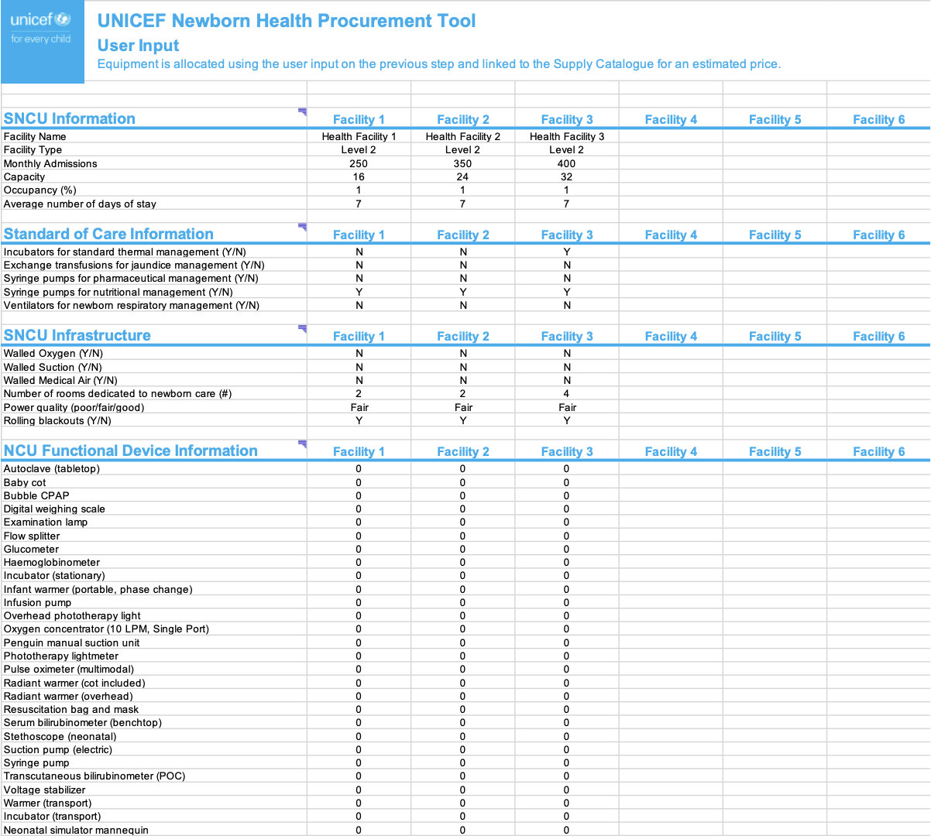
Devices, Consumables & Supplies
User information is collected to ensure the right devices & quantities are provided, linking user environments to device specifications
Notes:
Digital procurement guide & forecasting tool linked to the UNICEF supply catalog
Improve product availability by simplifying product selection & driving demand for comprehensive newborn care
Include newborn needs from Newborn Unit/Labour Ward/Health Technology Management Unit; training and care needs
Bundling for ease of purchase via unit category (e.g., devices, spares & consumables) and care pathway (e.g., jaundice management, thermal support)
Focus on appropriate selection within catalog/for each PO and quality implementation of these products

Slide 39
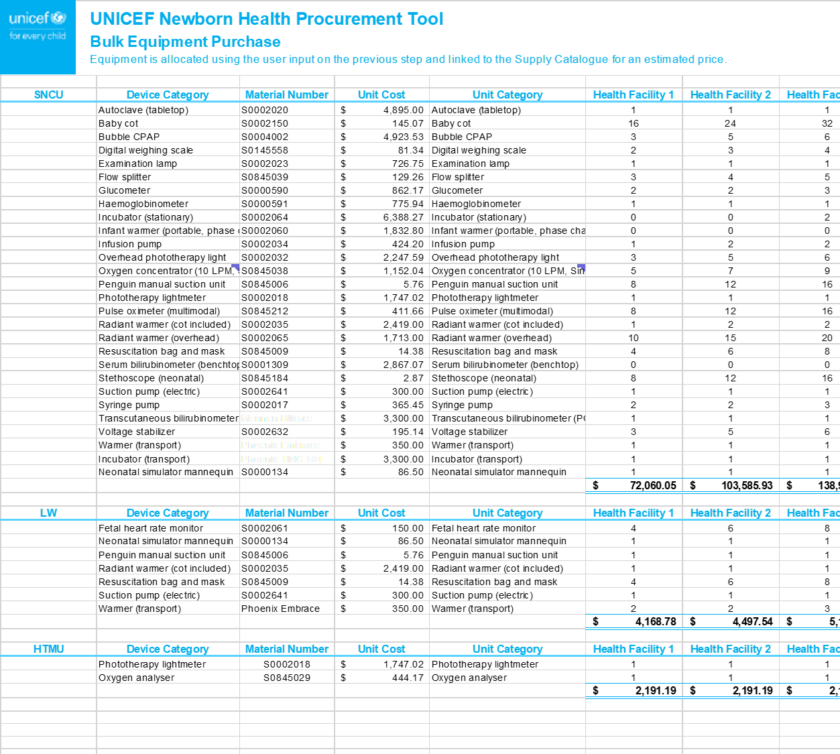
Devices, Consumables & Supplies
Appropriate UNICEF SD Supply Catalogue numbers autofill the device order with indicative pricing and suggested quantities for the SNCU, LW and HTMU

Slide 40
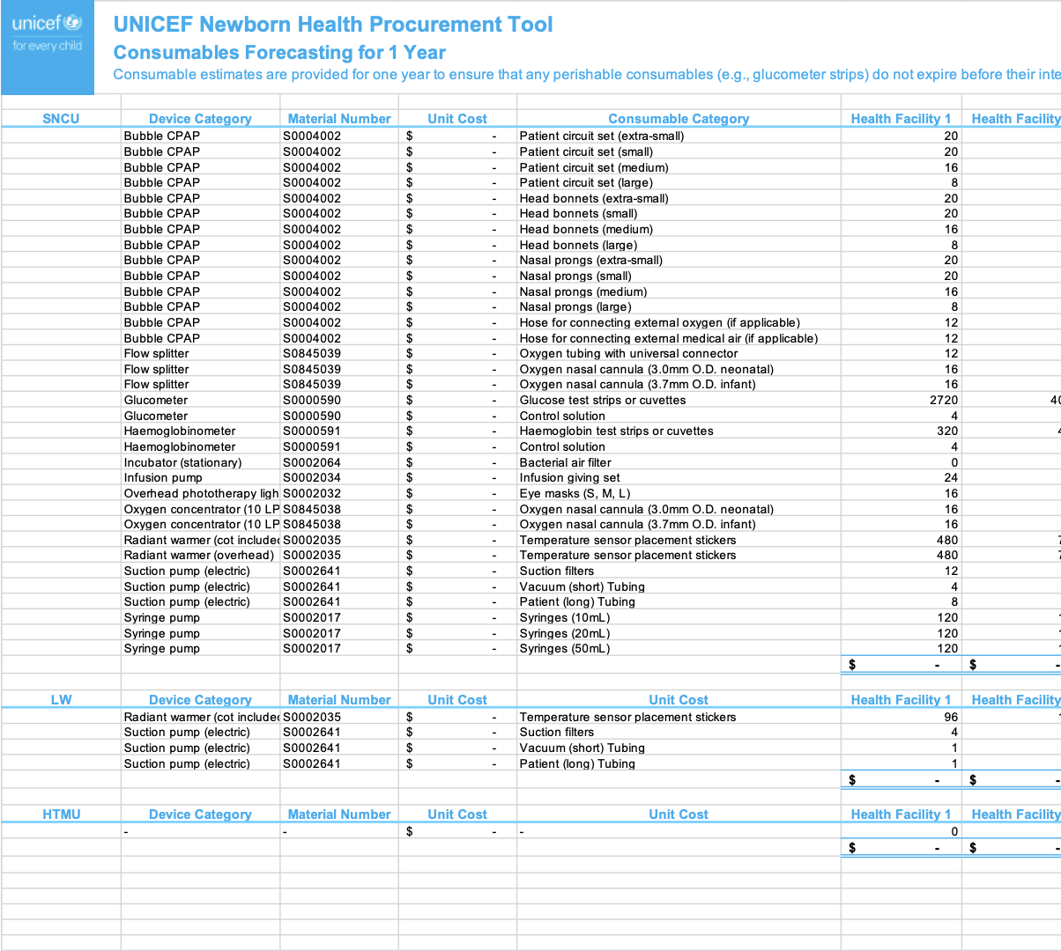
Devices, Consumables & Supplies
Device-specific consumables are collated in one location with the option of user-entered or SD costing & forecasting for 1 year
40 | UNICEF SD PIC: NBH

Slide 41
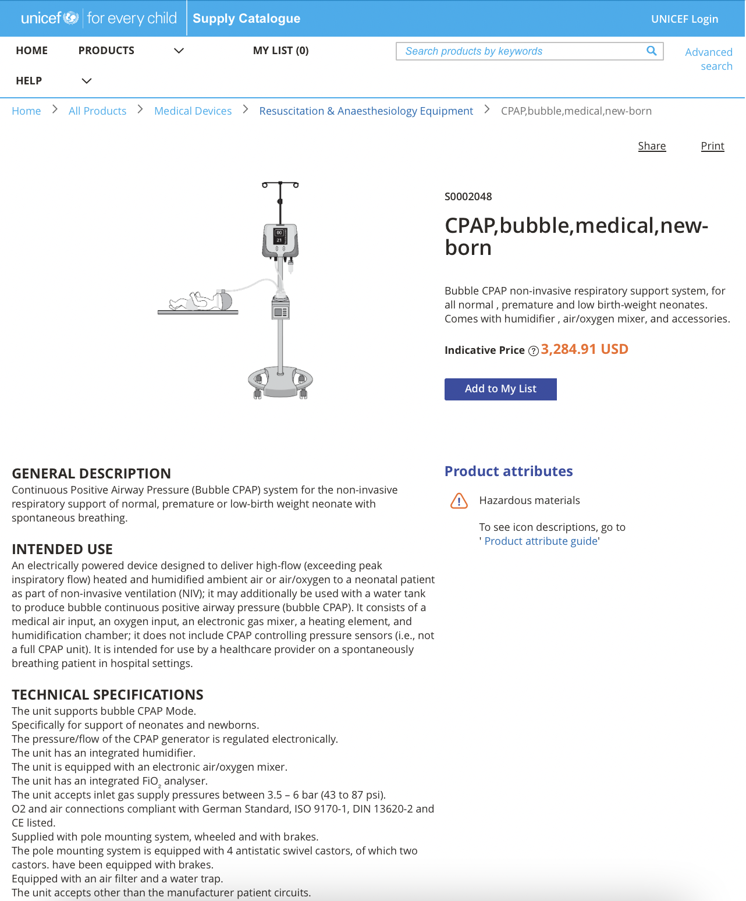
Devices, Consumables & Supplies
Output reports can be used to make POs through UNICEF Supply or can link to specifications and cost comparisons on the Supply website to ease local procurement

Slide 42
Key Takeaways
Effective implementation & uptake of bubble CPAP devices relies heavily on procuring products that are appropriate for available health facility infrastructure
For more information or support on newborn health innovations at UNICEF, please contact:
Sara Liaghati Mobarhan​
Newborn Health Innovation Specialist​
Product Innovation Centre​
UNICEF Supply Division ​
sliaghati@unicef.org
Florin Gheorghe
Innovation Specialist​
Product Innovation Centre​
UNICEF Supply Division ​
fgheorghe@unicef.org
Noah Mataruse​
Health Innovation Manger​
Product Innovation Centre​
UNICEF Supply Division ​
nmataruse@unicef.org​

